Slide 1
CS 111 Operating Systems
Week 3
01/24/2020
Nikita Sivakumar*
* In collaboration with TA Rishab

Slide 2
Things we are going to discuss:
Overview of Project 1B:The Big Picture
Socket
Address Domain
Socket Type
Reference:
https://www.cs.rpi.edu/~moorthy/Courses/os98/Pgms/socket.html
https://www.youtube.com/watch?v=LtXEMwSG5-8
TCP/UDP
Important functions for socket programming + Demo
Ports
Compression
zlib
--log
Shutdown Order

Slide 3
And as you know:
Project 1B
Spec: http://web.cs.ucla.edu/~harryxu/courses/111/winter20/ProjectGuide/P1B.html
Due on Wednesday (01/29/2020) at 11:59 PM
Late Policy : Exponential as discussed previously
Please remember to download your submissions and check if you submitted the correct files. Empty submissions - or submissions in the wrong format - cannot be graded and will therefore be scored with a 0

Slide 4
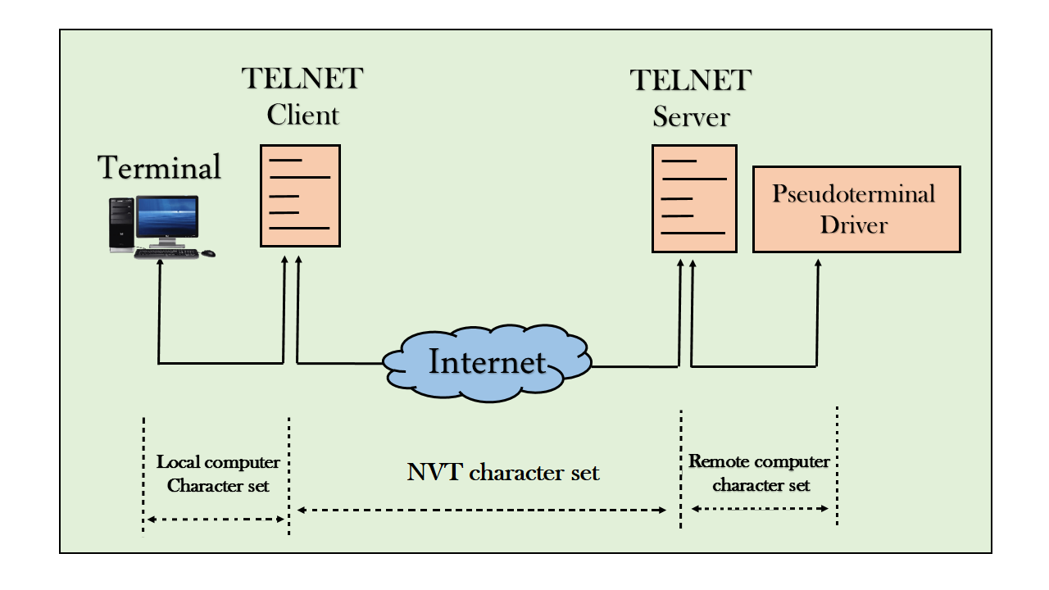
Project 1 - Telnet

Slide 5
Project 1A - Where are we?
1A
1B

Slide 6
Project 1A - Recap
STDIN
PARENT
CHILD
SHELL
→ → → → → → →
← ← ← ← ← ← ←
STDOUT
Output from parent
Input to parent

Slide 7
Project 1A - parent
Change keyboard input to character at a time, i.e., non-canonical input mode
termios, tcssetattr, tcsgetattr
Create a child shell process and execute commands
fork() to create, exec() to execute
Read input from keyboard pass it to child shell after processing
Read processed output from child shell

Slide 8
Project 1A - parent
Read input from keyboard
Display input on stdout (screen)
Send input to child-shell
Display processed output from child shell
Output of child-shell on processing must be shown on stdout (screen)

Slide 9
Project 1A - parent
Special cases:
If Ctrl+D is received from keyboard:
Stop reading input from keyboard
Process any remaining output from child shell
Restore normal terminal modes
Report the status
Exit the program

Slide 10
Project 1A - parent
Special cases:
If Ctrl+C is received from keyboard:
Stop reading input from keyboard
Use kill(2) to send a SIGINT to shell program
Process any remaining output from child shell
Restore normal terminal modes
Report the status
Exit the program
More special cases - <cr> / <lf> to <cr><lf>

Slide 11
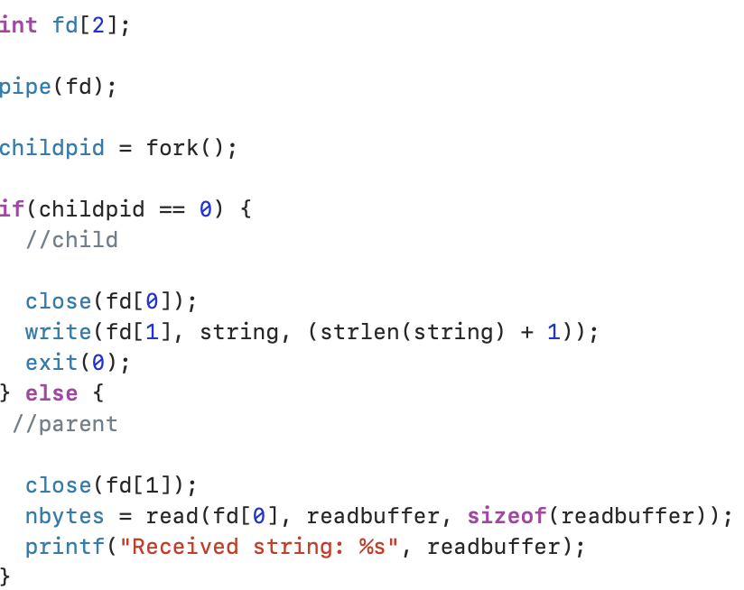
Project 1A - communication - Pipes recap
Unidirectional flow of data from one process to another.
Buffers data till read end of pipe doesn’t consume data present at write end of the pipe.

Slide 12
Pipes
Writing from child to parent:
Child: I don’t need read end of pipe, I will close it
Parent: I don’t need write end of pipe, I will close it
Child: I want to send a message to parent, I will write to write end of pipe
Parent: I want to receive messages from child, I will read from read end of pipe

Slide 13
Project 1a - pipes recap
2 pipes:
Write to child shell
Read from child shell
Parent, Child:
I don’t need to read from which pipe?,
I can close the read end of that pipe.
I don’t need to send data to which pipe?,
I can close the write end of that pipe.
STDIN
PARENT
CHILD
SHELL
→ → → → →
STDOUT
← ← ← ← ←
Output from parent
Input to parent

Slide 14
Project 1a - File Descriptors - Child
FD - Read end of pipe to child shell
STDIN
PARENT
CHILD
SHELL
→ → → → → → →
← ← ← ← ← ← ←
STDOUT
FD - Write end of pipe from child shell
Redirect / Change stdin and stdout of child shell to the appropriate pipe ends.
Recall dup()

Slide 15
Project 1a - File Descriptors - Parent
STDIN - Input from Keyboard
FD1 - Write end of pipe to child shell
STDIN
PARENT
CHILD
SHELL
→ → → → → → →
← ← ← ← ← ← ←
STDOUT
STDOUT - Output to monitor
FD2 - Read end of pipe from child shell

Slide 16
Project 1a - Poll
Parent reading from 2 inputs (highlighted in yellow).
Need to poll between the file descriptors to see if there is any new input
poll()
STDIN - Input from Keyboard
FD1 - Write end of pipe to child shell
STDIN
PARENT
CHILD
SHELL
→ → → → → → →
← ← ← ← ← ← ←
STDOUT
STDOUT - Output to monitor
FD2 - Read end of pipe from child shell

Slide 17
Project 1b
STDIN
TELNET
CLIENT
TELNET
SERVER
CHILD
SHELL
→ → → → → → →
TCP SOCKET
← ← ← ← ← ← ←
STDOUT

Slide 18
Project 1b
TCP Socket -
Socket is again a file descriptor
Full duplex - you can read and write from the same file descriptor
STDIN
PARENT
CHILD
SHELL
→ → → → →
STDOUT
← ← ← ← ←
TCP SOCKET
CHILD
SHELL
STDIN
TELNET
CLIENT
TELNET
SERVER
→ → → → → → →
→ → → → → → → → → → → →
← ← ← ← ← ← ← ← ← ← ← ←
← ← ← ← ← ← ←
STDOUT

Slide 19
Project 1b - File descriptors (TELNET client)
STDIN - Input from Keyboard
FD1 - Write end of pipe to child shell
TCP Socket -
Socket is again a file descriptor
Full duplex - you can read and write from the same file descriptor
STDIN
PARENT
CHILD
SHELL
→ → → → →
STDOUT
← ← ← ← ←
STDOUT - Output to monitor
FD2 - Read end of pipe from child shell
Modified file descriptors
STDIN - Input from Keyboard
TCP SOCKET
STDIN
TELNET
CLIENT
FD1 = SocketFD
TELNET
SERVER
CHILD
SHELL
→ → → → → → →
→ → → → → → → → → → → →
STDOUT - Output to monitor
← ← ← ← ← ← ← ← ← ← ← ←
← ← ← ← ← ← ←
STDOUT
FD2 = SocketFD

Slide 20
Project 1b - File descriptors (TELNET server)
STDIN - Input from Keyboard
FD1 - Write end of pipe to child shell
TCP Socket -
Socket is again a file descriptor
Full duplex - you can read and write from the same file descriptor
STDIN
PARENT
CHILD
SHELL
→ → → → →
STDOUT
← ← ← ← ←
STDOUT - Output to monitor
FD2 - Read end of pipe from child shell
Modified file descriptors
FD1 - Write end of pipe to child shell
TCP SOCKET
STDIN
TELNET
CLIENT
STDIN = SocketFD
TELNET
SERVER
CHILD
SHELL
→ → → → → → →
→ → → → → → → → → → → →
← ← ← ← ← ← ← ← ← ← ← ←
← ← ← ← ← ← ←
STDOUT
STDOUT = SocketFD
FD2 - Read end of pipe from child shell

Slide 21
Project 1b - Poll (TELNET client)
STDIN - Input from Keyboard
FD1 - Write end of pipe to child shell
TCP Socket -
Socket is again a file descriptor
Full duplex - you can read and write from the same file descriptor
STDIN
PARENT
CHILD
SHELL
→ → → → →
STDOUT
← ← ← ← ←
STDOUT - Output to monitor
FD2 - Read end of pipe from child shell
FD’s being polled
STDIN - Input from Keyboard
TCP SOCKET
STDIN
TELNET
CLIENT
FD1 = SocketFD
TELNET
SERVER
CHILD
SHELL
→ → → → → → →
→ → → → → → → → → → → →
STDOUT - Output to monitor
← ← ← ← ← ← ← ← ← ← ← ←
← ← ← ← ← ← ←
STDOUT
FD2 = SocketFD

Slide 22
Project 1b - Poll (TELNET server)
STDIN - Input from Keyboard
FD1 - Write end of pipe to child shell
TCP Socket -
Socket is again a file descriptor
Full duplex - you can read and write from the same file descriptor
STDIN
PARENT
CHILD
SHELL
→ → → → →
STDOUT
← ← ← ← ←
STDOUT - Output to monitor
FD2 - Read end of pipe from child shell
FD’s being polled
FD1 - Write end of pipe to child shell
TCP SOCKET
STDIN
TELNET
CLIENT
STDIN = SocketFD
TELNET
SERVER
CHILD
SHELL
→ → → → → → →
→ → → → → → → → → → → →
← ← ← ← ← ← ← ← ← ← ← ←
← ← ← ← ← ← ←
STDOUT
STDOUT = SocketFD
FD2 - Read end of pipe from child shell

Slide 23
Big Picture Review
The client is the side we type commands
The server gets the command via TCP connection and forwards to shell
The pipe is for the communication between the shell and the server
The server gets the output from shell and forwards that via TCP to the client
The TCP is for communication between client and server
What polling is happening?
Both client and server do polling for their own reasons
Client does polling between input from keyboard (stdin) and for reading the output returned from TCP connection with server
Server does polling between the input received from the TCP connection with client and the shell output received from the pipe

Slide 24
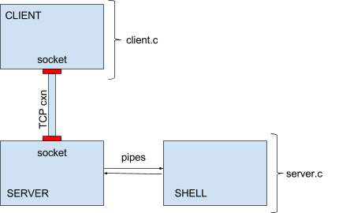
Project 1B: Compressed Network Communication
In this project, you will build a multi-process telnet-like client and server. This project is a continuation of Project 1A. It can be broken up into two major steps:
Passing input and output over a TCP socket.
Compressing communication between the client and server.

Slide 25
Introduction
Most interprocess communication uses the client server model.
One of the two processes, the client, connects to the other process, the server, typically to make a request for information.
Notice that the client needs to know of the existence of and the address of the server, but the server does not need to know the address of (or even the existence of) the client prior to the connection being established.
Once a connection is established, both sides can send and receive information.
The system calls for establishing a connection are somewhat different for the client and the server, but both involve the basic construct of a socket.
A socket is one end of an interprocess communication channel. The two processes each establish their own socket.

Slide 26
Some spec details
“The client program will open a connection to a server rather than sending it directly to a shell. The client should then send input from the keyboard to the socket (while echoing to the display), and input from the socket to the display”
So, how does a socket work?

Slide 27
Socket on the client side
The steps involved in establishing a socket on the client side are as follows:
Create a socket with the socket() system call
Connect the socket to the address of the server using the connect() system call
Send and receive data. There are a number of ways to do this, but the simplest is to use the read() and write() system calls

Slide 28
Socket on the server side
The steps involved in establishing a socket on the server side are as follows:
Create a socket with the socket() system call
Bind the socket to an address using the bind() system call. For a server socket on the Internet, an address consists of a port number on the host machine.
Listen for connections with the listen() system call
Accept a connection with the accept() system call. This call typically blocks until a client connects with the server.
Send and receive data

Slide 29
Socket
When a socket is created, the program has to specify the address domain and the socket type.
Two processes can communicate with each other only if their sockets are of the same type and in the same domain.
So, let’s discuss address domains and socket types.

Slide 30
Address Domain
There are two widely used address domains. Each of these has its own address format.
Unix domain :
Two processes which share a common file system communicate
The address of a socket in the Unix domain is a character string which is basically an entry in the file system.
Internet domain :
Two processes running on any two hosts on the Internet communicate
The address of a socket consists of the Internet address of the host machine (its IP address)
In addition, each socket needs a port number on that host. Port numbers are 16 bit unsigned integers. The lower numbers are reserved in Unix for standard services.
For example, the port number for the FTP server is 21. It is important that standard services be at the same port on all computers so that clients will know their addresses. However, port numbers above 2000 are generally available.

Slide 31
Socket Type
There are two widely used socket types, stream sockets, and datagram sockets.
Stream sockets:
Treat communications as a continuous stream of characters
Uses TCP (Transmission Control Protocol), which is a reliable, stream oriented protocol
Datagram sockets:
Have to read entire messages at once
Uses UDP (Unix Datagram Protocol), which is unreliable and message oriented.
The examples in this tutorial will use sockets in the Internet domain using the TCP protocol.

Slide 32
Quick overview on TCP and UDP
TCP is a standard that defines how to establish and maintain a network conversation through which application programs can exchange data.
TCP works with the IP (Internet Protocol), which defines how computers send packets of data to each other. Together TCP and IP are the basic rules defining the Internet.
TCP is a connection-oriented protocol, which means a connection is established and maintained until the application programs at each end have finished exchanging messages.
It determines how to break application data into packets that networks can deliver, sends packets to and accepts packets from the network layer, manages flow control and --because it is meant to provide error-free data transmission --handles retransmission of dropped or garbled packets as well as acknowledgement of all packets that arrive.
Where TCP provides error and flow control, no such mechanisms are supported in UDP. UDP is considered a connectionless protocol because it doesn't require a virtual circuit to be established before any data transfer occurs

Slide 33
Time for a client-server demo!
What are we trying to build?
A client and server that can communicate with each other
The server will first listen() and wait for a connection from the client
When the client is run, the server will accept the client’s connection
At this point, the client will prompt for stdin that it will send as a message to the server
The server receives this message, displays it on its stdout and sends back an acknowledgment to the client that it received the message

Slide 34
Demo code
Download these into files called server.c and client.c and compile them separately into two executables called server and client.
https://www.cs.rpi.edu/~moorthy/Courses/os98/Pgms/client.c
https://www.cs.rpi.edu/~moorthy/Courses/os98/Pgms/server.c

Slide 35
Demo Instructions - running the server
Ideally, you should run the client and the server on separate hosts on the Internet. Start the server first. Let us suppose the server is running on a machine called cheerios.
When you run the server, you need to pass the port number in as an argument. You can choose any number between 2000 and 65535.
If this port is already in use on that machine, the server will tell you this and exit. If this happens, just choose another port and try again.
If the port is available, the server will block until it receives a connection from the client. Don't be alarmed if the server doesn't do anything; it's not supposed to do anything until a connection is made.
Here is a typical command line: ./server 51717

Slide 36
Demo instructions - running the client
To run the client you need to pass in two arguments, the name of the host on which the server is running and the port number on which the server is listening for connections. Here is the command line to connect to the server described above: ./client cheerios 51717
The client will prompt you to enter a message. If everything works correctly, the server will display your message on stdout, send an acknowledgement message to the client and terminate. The client will print the acknowledgement message from the server and then terminate.
You can simulate this on a single machine by running the server in one window and the client in another. In this case, you can use the keyword localhost as the first argument to the client.

Slide 37
Socket in detail
Function signature: int socket(int domain, int type, int protocol);
The socket() function shall create an unbound socket in a communications domain, and return a file descriptor that can be used in later function calls that operate on sockets.
The socket() function takes the following arguments:
Domain
Specifies the communications domain in which a socket is to be created.
Type
Specifies the type of socket to be created.
Protocol
Specifies a particular protocol to be used with the socket. Specifying a protocol of 0 causes socket() to use an unspecified default protocol appropriate for the requested socket type.
Upon successful completion, socket() shall return a non-negative integer, the socket file descriptor. Otherwise, a value of -1 shall be returned and errno set to indicate the error.

Slide 38
Type and Domain in detail
Type:
SOCK_STREAM (compare to TCP): For a stream-oriented socket;
SOCK_DGRAM (compare to UDP): For a datagram-oriented socket that preserves message boundaries (as on most UNIX implementations, UNIX domain datagram sockets are always reliable and don't reorder datagrams);
SOCK_SEQPACKET (compare to SCTP): For a sequenced-packet socket that is connection-oriented, preserves message boundaries, and delivers messages in the order that they were sent.
Domain:
AF_INET : IPv4 Internet protocols
And many more

Slide 39
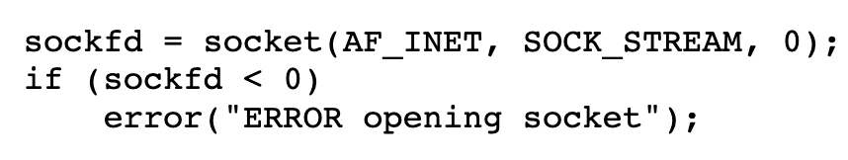
Example of a socket() call
Before we dive into the demo, let’s take a look at a socket() call:
Let’s see what each of these mean.

Slide 40
Example of a socket() call (continued)
The socket() system call creates a new socket. It takes three arguments. The first is the address domain of the socket. Recall that there are two possible address domains, the unix domain for two processes which share a common file system, and the Internet domain for any two hosts on the Internet.
The symbol constant AF_UNIX is used for the former, and AF_INET for the latter (there are actually many other options which can be used here for specialized purposes).
The second argument is the type of socket. Recall that there are two choices here, a stream socket in which characters are read in a continuous stream as if from a file or pipe, and a datagram socket, in which messages are read in chunks. The two symbolic constants are SOCK_STREAM and SOCK_DGRAM.

Slide 41
Example of a socket() call (continued)
The third argument is the protocol. If this argument is zero (and it always should be except for unusual circumstances), the operating system will choose the most appropriate protocol. It will choose TCP for stream sockets and UDP for datagram sockets.
The socket system call returns an entry into the file descriptor table (i.e. a small integer). This value is used for all subsequent references to this socket. If the socket call fails, it returns -1. In this case the program displays and error message and exits. However, this system call is unlikely to fail.
This is a simplified description of the socket call; there are numerous other choices for domains and types, but these are the most common

Slide 42
Quick look at some useful functions
Let’s quickly run through some functions that might help us understand the server.c code better
Functions we will discuss:
bzero()
htons()
bind()
listen()
accept()
read()
write()

Slide 43
bzero() - quick look at this useful function
Function Signature: void bzero(void *s, int nbyte);
This function does not return anything.
Example:
The function bzero() sets all values in a buffer to zero.
It takes two arguments, the first is a pointer to the buffer and the second is the size of the buffer.
Thus, this line initializes serv_addr to zeros.

Slide 44
htons() - a quick look at this useful function
htons is host-to-network short
This means it works on 16-bit short integers. i.e. 2 bytes.
This function swaps the endianness of a short.
Example:
The decimal number 5001 is 1389 in hexadecimal, so the bytes involved are 13 and 89.
Many devices store numbers in little-endian format, meaning that the least significant byte comes first.
So in this particular example it means that in memory the number 5001 will be stored as 13 89
Note that if you were working on a big-endian machine, the htons() function would not need to do any swapping since the number would already be stored in the right way in memory.

Slide 45
bind() - a quick look at this useful function
Function Signature:
int bind(int sockfd, const struct sockaddr *addr, socklen_t addrlen);
bind() assigns the address specified by addr to the socket referred to by the file descriptor sockfd.
addrlen specifies the size, in bytes, of the address structure pointed to by addr.
When a socket is created with socket(), it exists in a namespace (address family) but has no address assigned
The bind() system call binds a socket to an address, in this case the address of the current host and port number on which the server will run
It takes three arguments:
Socket file descriptor
Address to which is bound: Pointer to a structure of type sockaddr, but what is passed in is a structure of type sockaddr_in, and so this must be cast to the correct type
Size of the address to which it is bound
This can fail for a number of reasons, the most obvious being that this socket is already in use on this machine
Returns 0 for success, -1 for error

Slide 46
listen() - a quick look at a useful function
Function Signature: int listen(int sockfd, int backlog);
listen() marks the socket referred to by sockfd as a passive socket,that is, as a socket that will be used to accept incoming connection requests using accept()
The first argument is the socket file descriptor, and the second is the size of the backlog queue, i.e., the number of connections that can be waiting while the process is handling a particular connection.
The sockfd argument is a file descriptor that refers to a socket of type SOCK_STREAM or SOCK_SEQPACKET.
The backlog argument defines the maximum length to which the queue ofpending connections for sockfd may grow.
The listen system call allows the process to listen on the socket for connections.
The backlog argument should be set to 5, the maximum size permitted by most systems.
If the first argument is a valid socket, this call cannot fail, and so the code doesn't check for errors

Slide 47
accept() - a quick look at a useful function
Function Signature: int accept(int sockfd, struct sockaddr *addr, socklen_t *addrlen);
The accept() system call is used with connection-based socket types (SOCK_STREAM, SOCK_SEQPACKET).
It extracts the first connection request on the queue of pending connections for the listening socket, sockfd, creates a new connected socket, and returns a new file descriptor referring to that socket. The newly created socket is not in the listening state.
The original socket sockfd is unaffected by this call.
sockfd is a socket that has been created with socket(),bound to a local address with bind(), and is listening for connections after a listen().
On success, these system calls return a nonnegative integer that is a file descriptor for the accepted socket.
On error, -1 is returned,errno is set appropriately, and addrlen is left unchanged.

Slide 48
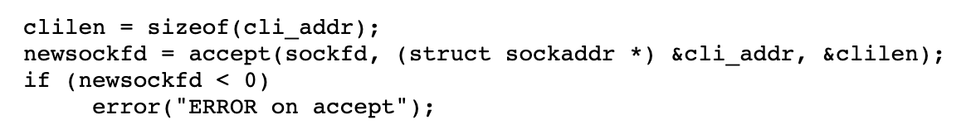
accept() - Example
The accept() system call causes the process to block until a client connects to the server.
Thus, it wakes up the server process when a connection from a client has been successfully established.
It returns a new file descriptor, and all communication on this connection should be done using the new file descriptor.
The second argument is a reference pointer to the address of the client on the other end of the connection, and the third argument is the size of this structure.

Slide 49
socket() and accept() big picture
Each running process has a file descriptor table which contains pointers to all open i/o streams. When a process starts, three entries are created in the first three cells of the table. Entry 0 points to standard input, entry 1 points to standard output, and entry 2 points to standard error.
Whenever a file is opened, a new entry is created in this table, usually in the first available empty slot.
The socket system call returns an entry into this table; i.e. a small integer. This value is used for other calls which use this socket.
The accept system call returns another entry into this table. The value returned by accept is used for reading and writing to that connection

Slide 50
read(), write() - some useful tips
Note that the read call uses the new file descriptor, the one returned by accept(), not the original file descriptor returned by socket().
Note also that the read() will block until there is something for it to read in the socket, i.e. after the client has executed a write().
It will read either the total number of characters in the socket or 255, whichever is less
Returns the number of characters read
Once a connection has been established, both ends can both read and write to the connection.
Naturally, everything written by the client will be read by the server, and everything written by the server will be read by the client.

Slide 51
server code run-through

Slide 52
Quick look at some useful functions
Let’s quickly run through some functions that might help us understand the client.c code better
Functions we will discuss:
hostent()
bcopy()
connect()

Slide 53
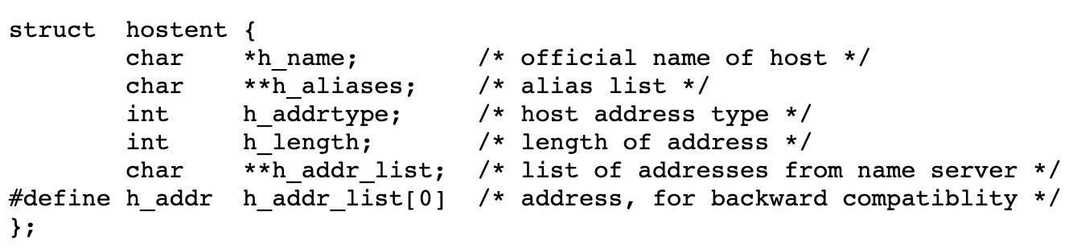
hostent()
The variable server is a pointer to a structure of type hostent. This structure is defined in the header file netdb.h as follows:

Slide 54
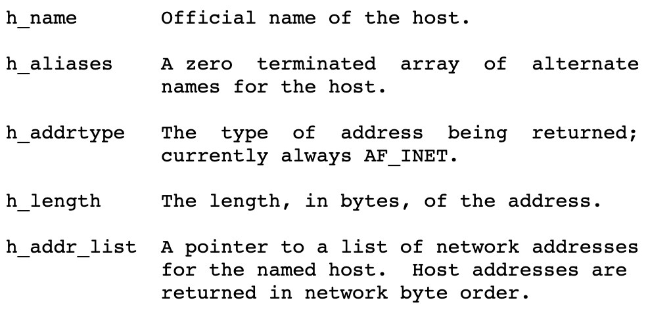
hostent() (continued)
It defines a host computer on the Internet. The members of this structure are:

Slide 55
hostent() (continued)
Takes such a name as an argument and returns a pointer to a hostent containing information about that host.
The field char *h_addr contains the IP address.
If this structure is NULL, the system could not locate a host with this name.
The mechanism by which this function works is complex, often involves querying large databases all around the country.
Example usage:
struct hostent *server;
server = gethostbyname(argv[1]);

Slide 56
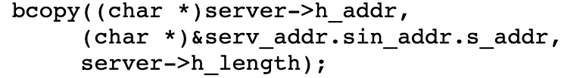
bcopy()
void bcopy(char *s1, char *s2, int length)copies length bytes from s1 to s2.
So once we have set char *h_addr, we can copy it onto the
(char *)&serv_addr.sin_addr.s_addr field
Usage example:

Slide 57
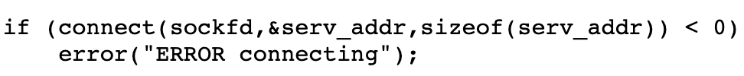
connect()
The connect function is called by the client to establish a connection to the server.
It takes three arguments, the socket file descriptor, the address of the host to which it wants to connect (including the port number), and the size of this address.
This function returns 0 on success and -1 if it fails.
Example usage:

Slide 58
client code run-through

Slide 59
Socket Quick Review
These functions are used by the user process to send or receive packets and to do other socket operations.
socket() creates a socket
connect() connects a socket to a remote socket address,
bind() function binds a socket to a local socket address
listen() tells the socket that new connections shall be accepted
accept() is used to get a new socket with a new incoming connection.
The standard I/O operations like write(), writev(), sendfile(), read() and readv() can be used to read and write data.
getsockname() returns the local socket address and getpeername() returns the remote socket address.
getsockopt() and setsockopt() are used to set or get socket layer or protocol options.
(http://man7.org/linux/man-pages/man7/socket.7.html)

Slide 60
What are ports?
Any server machine makes its services available to the Internet using numbered ports, one for each service that is available on the server.
For example, if a server machine is running a Web server and an FTP server, the Web server would typically be available on port 80, and the FTP server would be available on port 21.
Clients connect to a service at a specific IP address and on a specific port.

Slide 61
What are ports? (continued)
If the server machine accepts connections on a port from the outside world, and if a firewall is not protecting the port, you can connect to the port from anywhere on the Internet and use the service.
Note that there is nothing that forces, for example, a Web server to be on port 80. If you were to set up your own machine and load Web server software on it, you could put the Web server on port 918, or any other unused port, if you wanted to.
Then, if your machine were known as xxx.yyy.com, someone on the Internet could connect to your server with the URL http://xxx.yyy.com:918.
The ":918" explicitly specifies the port number, and would have to be included for someone to reach your server.
When no port is specified, the browser simply assumes that the server is using the well-known port 80.

Slide 62
What are ports? (continued)
In both TCP and UDP, port numbers start at 0 and go up to 65535. Numbers in the lower ranges are dedicated to common internet protocols such as port 25 for SMTP and port 21 for FTP.
It is important that standard services be at the same port on all computers so that clients will know their addresses.
However, port numbers above 2000 are generally available.

Slide 63
Data Compression
The purpose of compression is to reduce the amount of space data takes up.
In communications scenarios, a compressed version of data will use less bandwidth to transmit the same data than its uncompressed form would use.
On the other hand, compression will require processing at the sending and receiving end before the data can be effectively used at the receiving process.
Sometimes the benefits in reduced bandwidth are worth the costs of extra processing and sometimes they are not, so compression is not used by default in network communications.
Add a --compress command line option to your client and server which, if included, will enable compression (of all traffic in both directions).
Modify both the client and server applications to compress traffic before sending it over the network and decompress it after receiving it.

Slide 64
Data Compression (Server and Client)
 | Compressed data flowing through TCP sockets
 | Compress STDIN and send to socket
 | Decompress socket data and send to child shell’s STDIN
 | Compress child shell’s STDOUT and send to socket
 | Decompress socket data and send to client’s STDOUT
STDIN
TELNET
CLIENT
TCP SOCKET
TELNET
SERVER
CHILD
SHELL
→ → → → → → →
→ → → → → → → →
← ← ← ← ← ← ← ← ←
← ← ← ← ← ← ←
STDOUT

Slide 65
Zlib usage
Create zpipe.c
Compile with -lz flag for including the zlib header file: gcc -o zpipe -lz zpipe.c
Compress a file(Deflate): ./zpipe < src > srcCompressed
Decompress a file(Inflate): ./zpipe -d < srcCompressed > srcDecompressed
Diff decompressed file and original file: diff src srcDecompressed

Slide 66
Demo Zlib

Slide 67
Zlib compression - man
Zlib Metadata: The zlib format has a very small header of only two bytes to identify it as a zlib stream and to provide decoding information, and a four-byte trailer with a fast check value to verify the integrity of the uncompressed data after decoding.
Zlib allows you to define compression levels in the range of -1 to 9. Lower compression levels result in faster execution, but less compression. Higher levels result in greater compression, but slower execution. The zlib constant Z_DEFAULT_COMPRESSION, equal to -1, provides a good compromise between compression and speed and is equivalent to level 6.
Zlib state is inside a struct called as z_stream_s, we are mainly responsible for these 3 fields:
alloc_func zalloc; /* used to allocate the internal state */
free_func zfree; /* used to free the internal state */
voidpf opaque; /* private data object passed to zalloc and zfree */
The application must initialize zalloc, zfree and opaque before calling the init function. All other fields are set by the compression library and must not be updated by the application.
When zalloc and zfree are Z_NULL on entry to the initialization function, they are set to internal routines that use the standard library functions malloc() and free().
We will set zalloc and zfree to Z_NULL

Slide 68
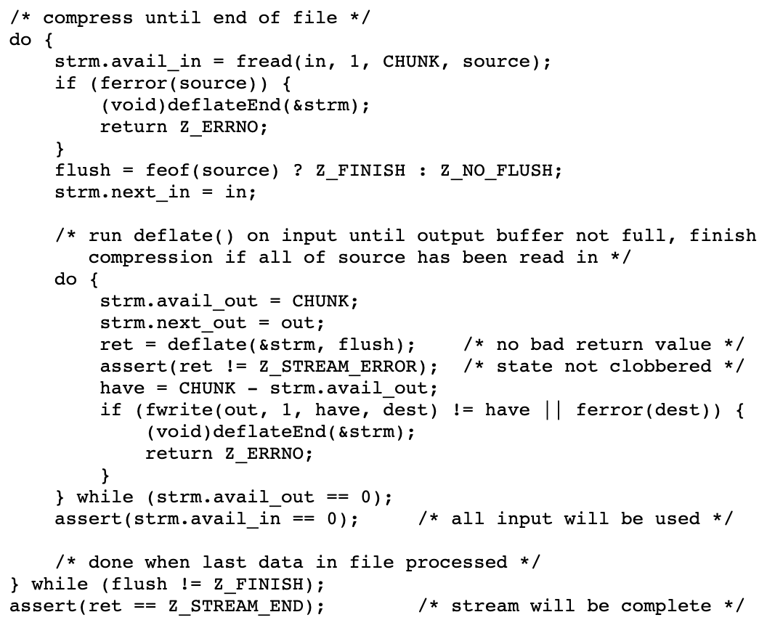
Deflate (Compress)
deflate(): takes as many of the avail_in bytes at next_in as it can process, and writes as many as avail_out bytes to next_out.
Those counters and pointers are then updated past the input data consumed and the output data written.
It is the amount of output space available that may limit how much input is consumed.
Hence the inner loop to make sure that all of the input is consumed by providing more output space each time.
Since avail_in and next_in are updated by deflate(), we don't have to mess with those between deflate() calls until it's all used up.

Slide 69
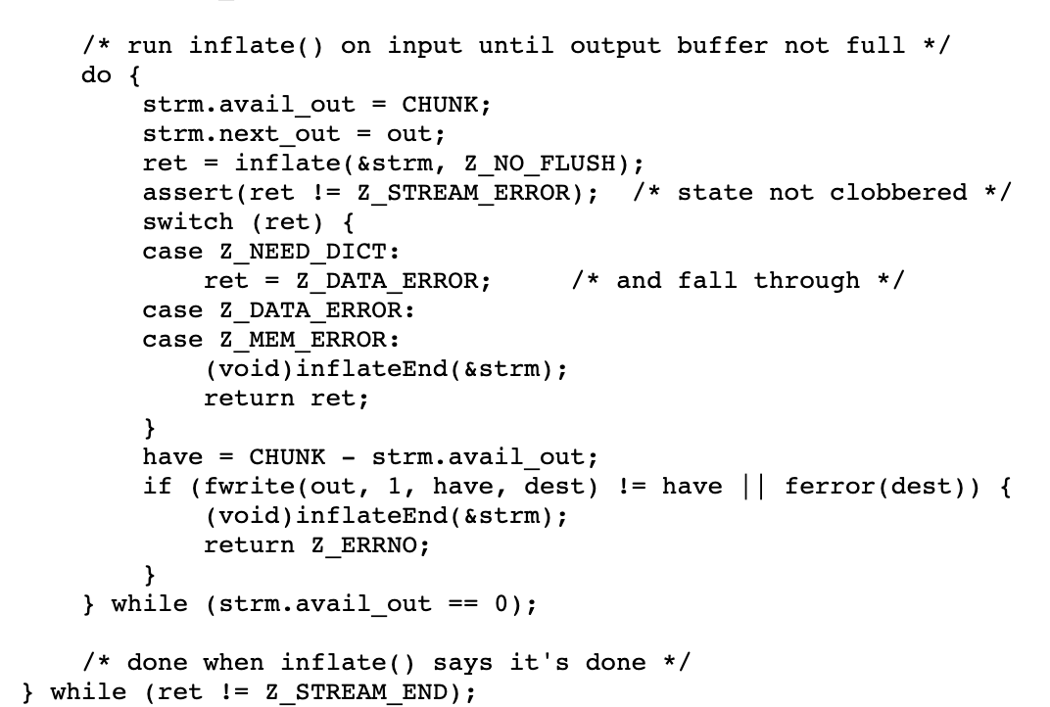
Inflate (Decompress)
The outer do-loop decompresses input until inflate() indicates that it has reached the end of the compressed data and has produced all of the uncompressed output.
The inner do-loop has the same function it did in def(), which is to keep calling inflate() until has generated all of the output it can with the provided input.
The inner do-loop ends when inflate() has no more output as indicated by not filling the output buffer, just as for deflate(). In this case, we cannot assert that strm.avail_in will be zero, since the deflate stream may end before the file does.
The outer do-loop ends when inflate() reports that it has reached the end of the input zlib stream, has completed the decompression and integrity check, and has provided all of the output. This is indicated by the inflate() return value Z_STREAM_END. The inner loop is guaranteed to leave ret equal to Z_STREAM_END if the last chunk of the input file read contained the end of the zlib stream. So if the return value is not Z_STREAM_END, the loop continues to read more input.

Slide 70
The --log option
To ensure that compression is being correctly done, we will ask you to add a --log=filename option to your client. If this option is specified, all data written to or read from the server should be logged to the specified file.
Prefix each log entry with SENT # bytes: or RECEIVED # bytes: as appropriate.
(Note the colon and space between the word bytes and the start of the data). Each of these lines should be followed by a newline character (even if the last character of the reported string was a newline).
Before running your program in a mode that creates a log file, please use the ulimit command to ensure that your log file does not get too large, which could happen if you have a bug in your program. ulimit 10000 should be sufficient, but check out the ulimit man page for further details.
Failing to limit the size of log files has filled up the HSSEAS Linux servers' /tmp directories in the past, which makes the machines hard to use for everybody, including you.
Sample log format output: SENT 35 bytes: sendingsendingsendingsendingsending RECEIVED 18 bytes: receivingreceiving

Slide 71
Shut down order
If the client initiates the closing of the socket, it may not receive the last output from the shell. To ensure that no output is lost, shut-downs should be initiated from the server side:
an exit(1) command is sent to the shell, or the server closes the write pipe to the shell.
the shell exits, causing the server to receive an EOF on the read pipe from the shell.
the server collects and reports the shell's termination status.
the server closes the network socket to the client, and exits.
the client continues to process output from the server until it receives an error on the network socket from the server.
the client restores terminal modes and exits.
After reporting the shell's termination status and closing the network socket, the server should exit. Otherwise it would tie up the socket and prevent testing new server versions.
After your test is complete, the client, server, and shell should all be gone. There should be no remaining orphan processes.

Slide 72
Questions?
Do you need to save and restore both clients and servers terminal modes?
Who exits first? Client or Server?
What all errors should you handle?
Polling on server and client should happen on which file descriptors?
What events should you poll on?
What flush flag is ideal for our use case?

Slide 73
Thank you!

